Slide 1



Stable Diffusion
Images to Prompts
Group 07
Aman Patel
Kamal Panchal
Praveen Thanniru
Rahul Parupati

Slide 2
Agenda
Introduction
Competition Overview & Goal
Data Sources
Model selection
Evaluation
Conclusion

Slide 3


Introduction
Stable Diffusion is a deep learning model that generates detailed images based on text descriptions.
It can also be used for tasks like inpainting and outpainting.
The model was developed by Stability AI in collaboration with academic researchers and non-profit organizations.

Slide 4
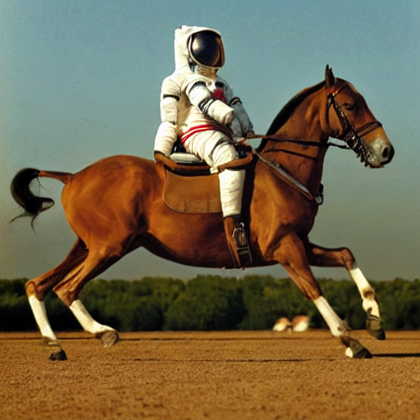
Image generated by stable diffusion
Prompt used :
"a photograph of an astronaut
riding a horse"

Slide 5
Goal of Competition
Image to Prompts

Slide 6
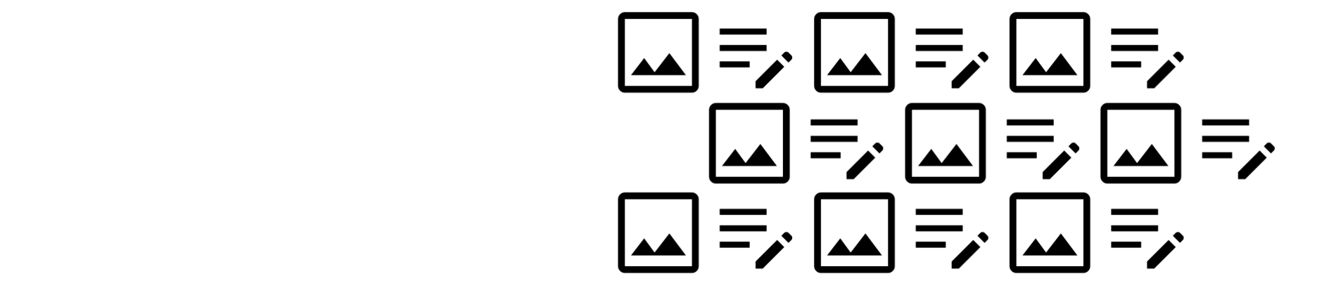
Competition
overview & Goal
To reverse the direction of generative text to image model.
Instead of generating image from prompt, we have to predict prompt from generated image.
Creating a model that can reliably invert diffusion process that generated to a given image.
Text embeddings to the generated prompts to be submitted as deliverables.

Slide 7
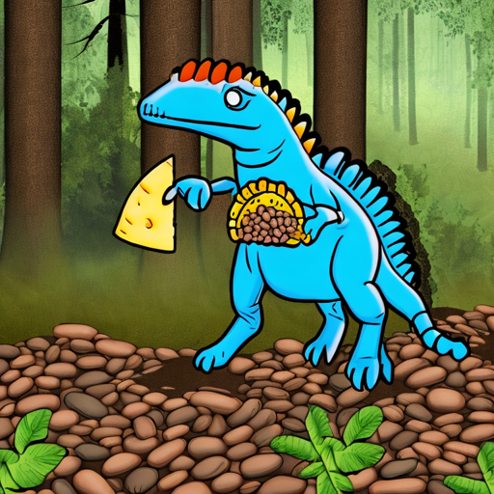
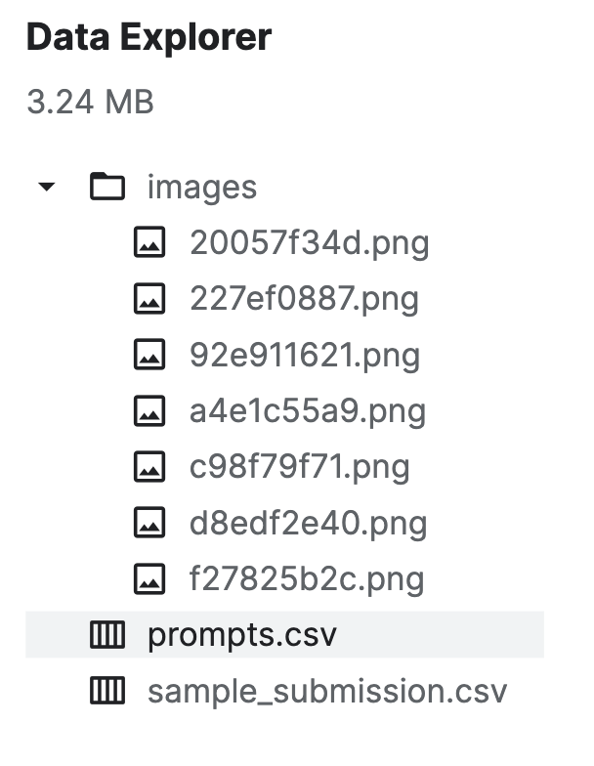
Data Sources
'ultrasaurus holding a black bean taco in the woods,
near an identical cheneosaurus'

Slide 8
Related Work
CLIP Interrogator
Contrastive Language Image Pre-training
The CLIP Interrogator is a prompt engineering tool that combines OpenAI’s CLIP and Salesforce’s BLIP to optimize text prompts to match a given image.

Slide 9
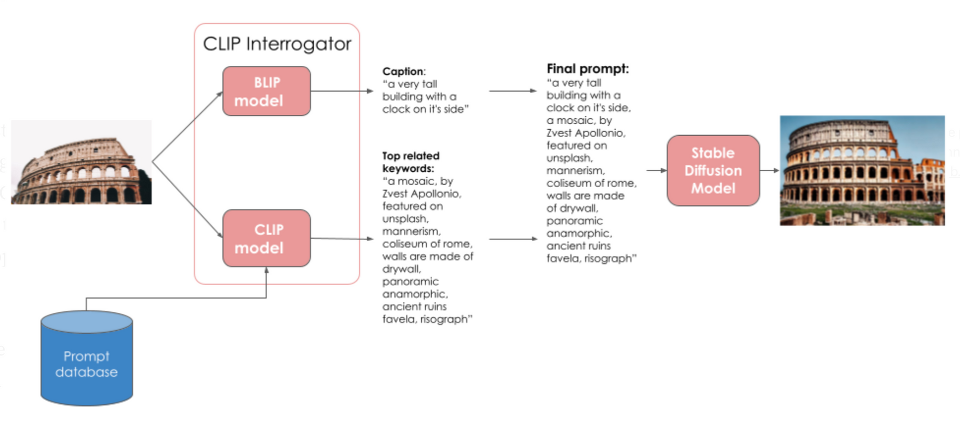
CLIP interrogator
The BLIP model receives an input image and creates a caption.
The CLIP model is used for text-image retrieval. CLIP model searches the Prompt database for the top-ranking keywords that match the content of the input image.
The caption from BLIP and the top-related words from CLIP will be merged to form the final prompt.

Slide 10
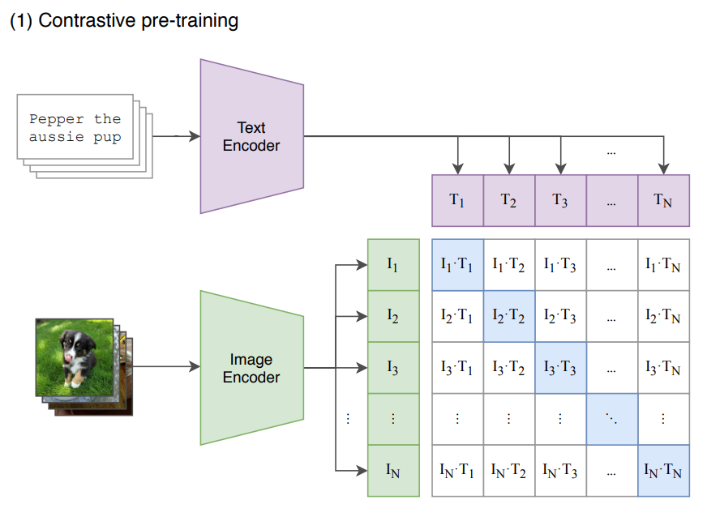
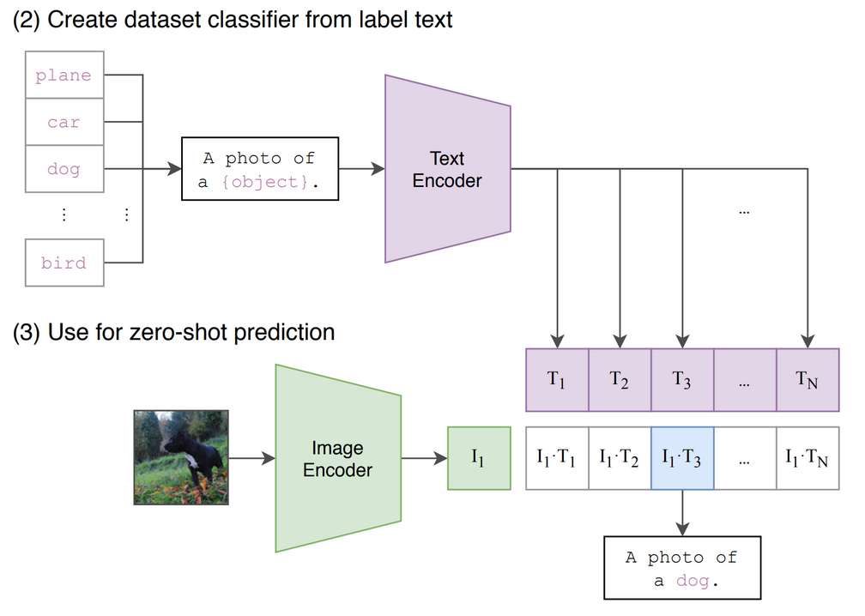
CLIP explained
The model receives a batch of N <image-text> pairs.
The Text Encoder is a standard Transformer model with GPT2-style modifications. The Image Encoder can be either a ResNet or a Vision Transformer.
For every image in the batch, the Image Encoder computes an image vector. The first image corresponds to the I1 vector, the second to I2 , and so on.
Similarly, the textual descriptions are squashed into text embeddings [T1, T2 … TN]
In a contrastive fashion, a matrix will be created such that the best possible image prompt pairs will be formed on diagonal.
Zero shot predictions can be done on trained CLIP model by passing label texts to the text encoder and testing with unseen image.

Slide 11


Slide 12
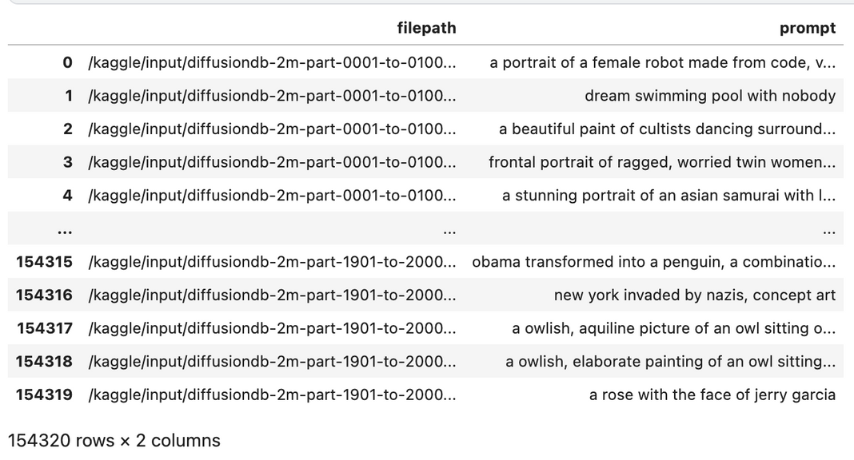
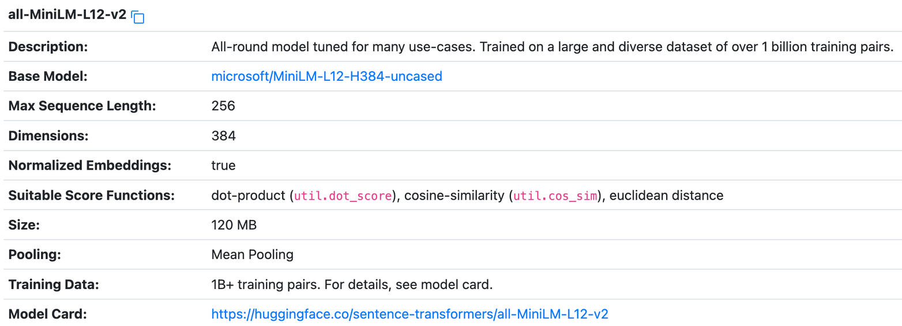
Training Data
We used 154320 image prompt pairs available in kaggle to finetune our custom proposed models.
These images are generated by those corresponding prompts using Stable Diffusion 2.0
Sentence Transformer
SentenceTransformers is a Python framework for state-of-the-art sentence, text and image embeddings.

Slide 13
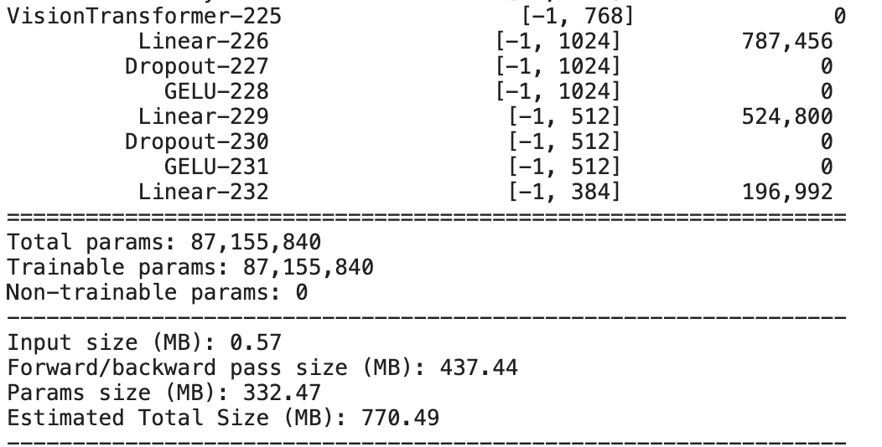
Proposed Model
Customized Vision Transformer - replaced final classification head with 3 fully connected layers separated by Dropout and GELU activation function.
ViT Backbone + Customized fully connected layers

Slide 14

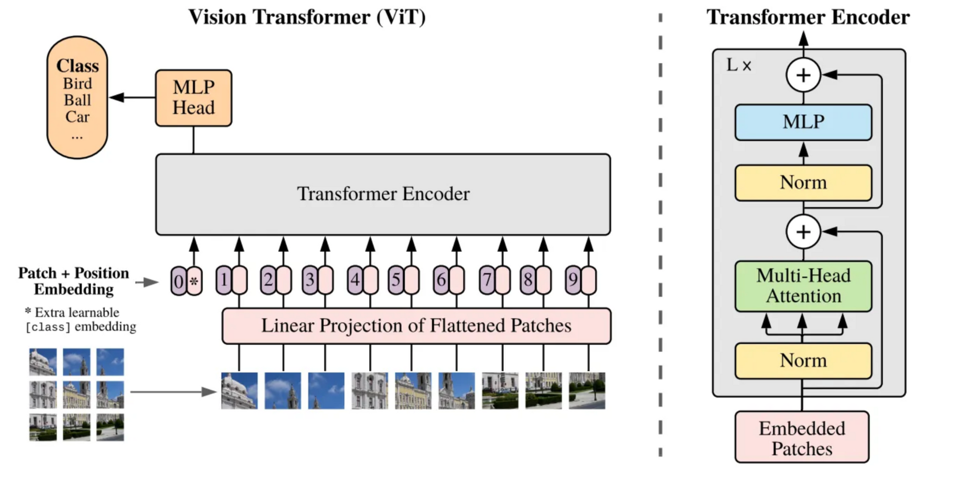

3 fully connected layers with final layer consisting 384 units
Custom

Slide 15



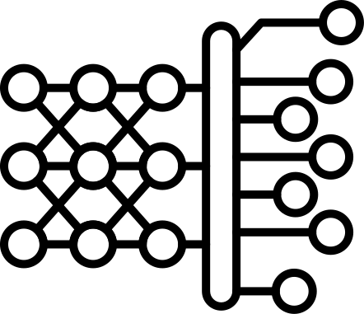



Custom ViT training
Image
Prompt
Sentence
Transformer
Custom ViT
Image Embedding
Text Embedding
0.2
0.4
0.9
--
0.6
0.3
0.8
--

Slide 16
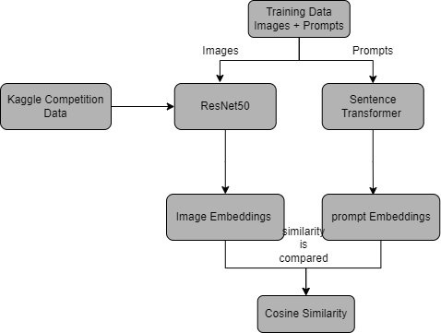
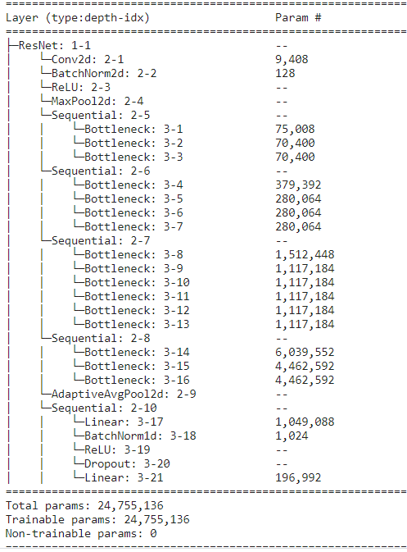
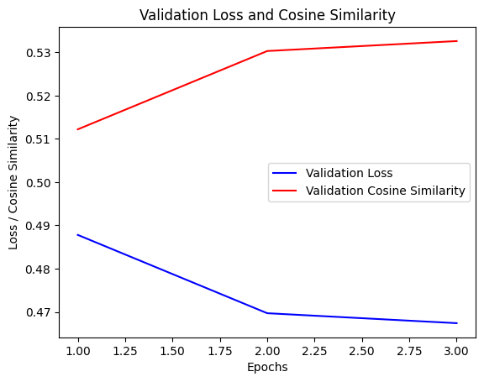
Modeling(ResNet)
Cosine Similarity of 50.619 %
Adaptive average pooling layer,Batch Normalization and Drop out layers are introduced in final layers.

Slide 17
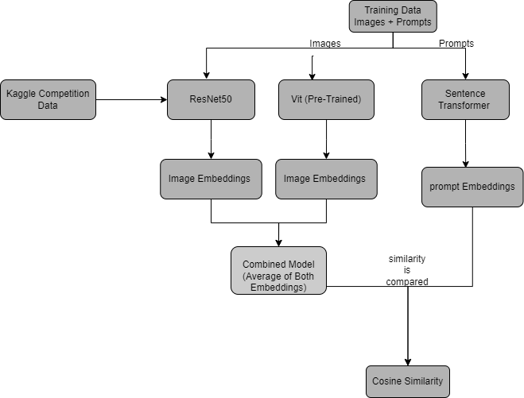
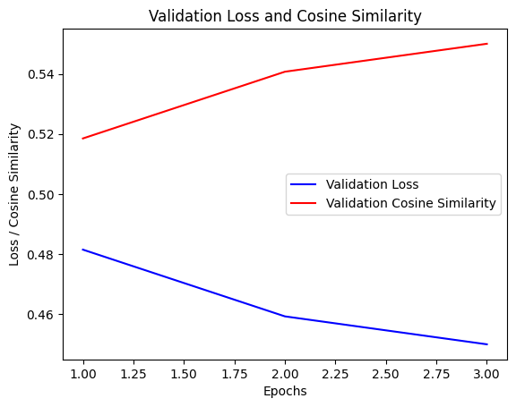
Modeling(ResNet + Vit)
ResNet50 has a strong structural bias towards local connections between adjacent layers due to its residual blocks.
ViT has a higher inductive bias towards the input structure.
the attention mechanism used in visual transformers allows them to selectively focus on relevant image regions

Slide 18
Cosine Similarity
Cosine similarity is a measure of similarity between two non-zero vectors of an inner product space that calculates the cosine of the angle between them, ranging from -1 (completely dissimilar) to 1 (completely similar).
In our work, cosine similarity is used as a performance metric to evaluate the quality of the image embeddings generated by the model, measuring the similarity between the model's output and the ground truth text embeddings.
Higher cosine similarity values indicate better model performance, as it means the generated embeddings are closer to the true embeddings, effectively representing the prompts.

Slide 19
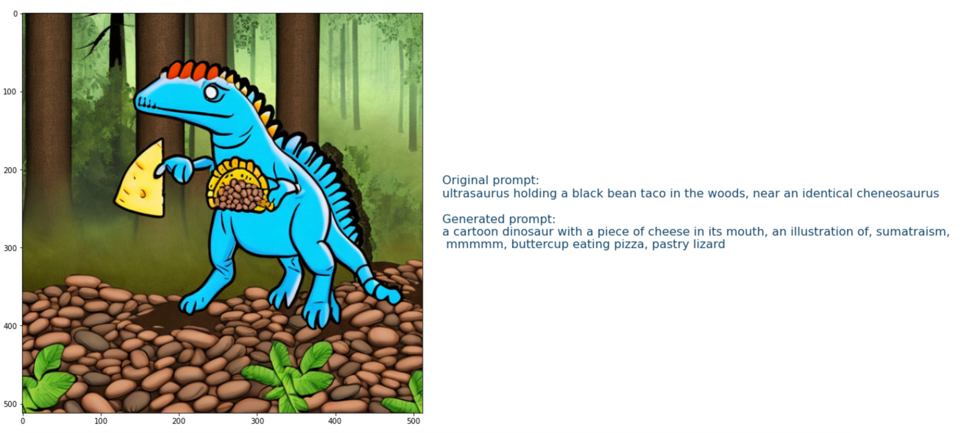

Model Evaluation
The fine-tuned model is then used to predict embeddings for the 7 test images provided by Kaggle.
Generated 384 embeddings per image and in total 2688 embeddings were generated and submitted to the competition.

Slide 20
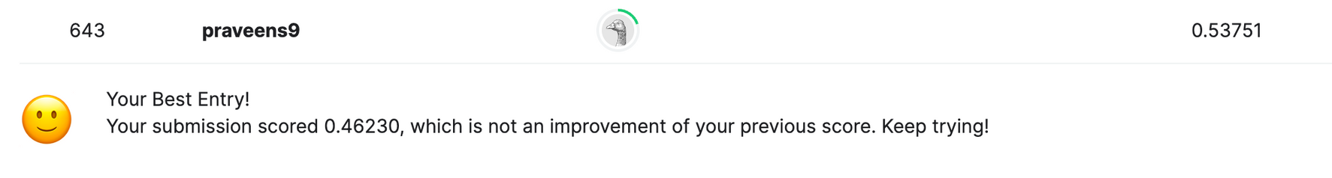
Results
On comparing both the all the models, the ensemble of CLIP and ViT gave the highest score on Kaggle competition after successful submission
Final embeddings = 0.25*(CLIP embeddings) + 0.75*(Custom ViT embeddings)

Slide 21
Conclusion
Objective: We aimed to reverse the text-to-image generative process using the Stable Diffusion 2.0 model.
Approach: Our ensemble model combined the CLIP Interrogator and a Custom Vision Transformer.
Performance: We achieved a score of 0.53751, ranking #643 on the Kaggle leaderboard.
Key Insights: Our work revealed insights into the reversibility of text-to-image models and the latent relationships between text prompts and images.
This project highlights the potential of ensemble models and customized architectures to tackle complex tasks like reversing text-to-image generative processes.

